Slide 1
KTM CUSTOMIZED JERSEY
Done by;
1. Student 1
2. Student 2
3. Student 3
4. Student 4

Slide 2
REQUIREMENTS ACHIEVED
Customer can create an account via signup
Customer with account can login to KTM Customized Jersey ecommerce
Customer can logout of the KTM ecommerce system
Customer can browse jersey products displayed by the system.
Customer can add to cart while browsing other type of jersey products
Customer can add/change the quantity of specific product based on his/her preference.
Customer can choose their own preferred type i.e xxl, s, m, l, xl
Customer have the ability to write their name to be printed on the jersey.
If customer add a product to the cart by mistake, he/she can still remove from the list of products selected in the cart.
Customer is able to checkout after choosing his/her own preference from the ecommerce system.
Customer can learn what is KTM Customized Jersey by going to about page.
Customer can contact us via the contact page where they feed in their details and the message on what they want help.

Slide 3
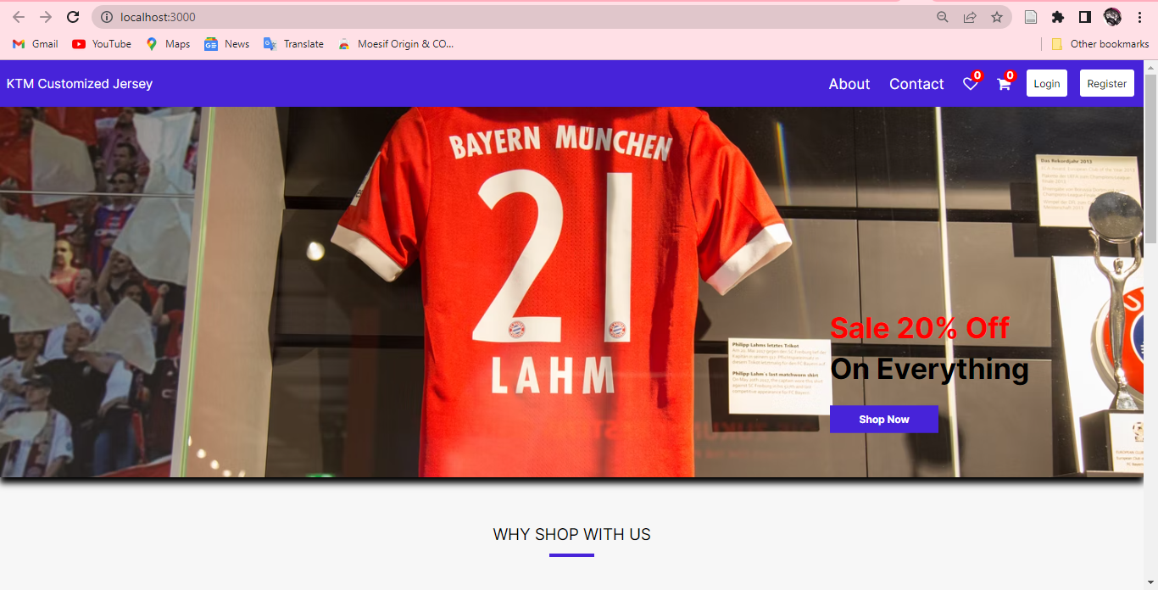
HOME PAGE/LANDING PAGE

Slide 4
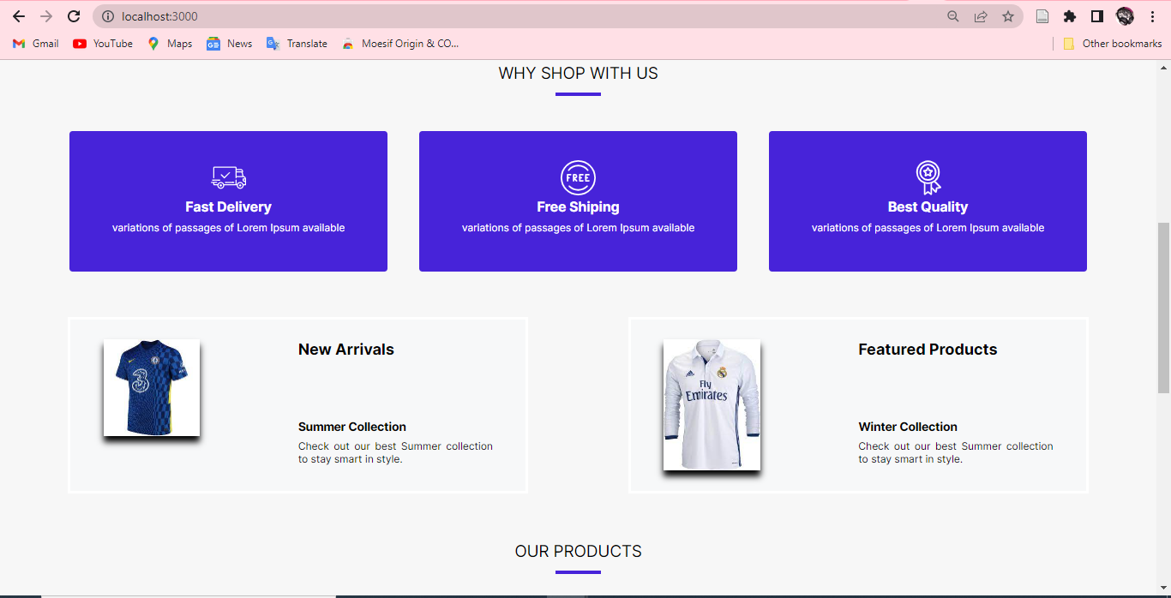
WHY US

Slide 5
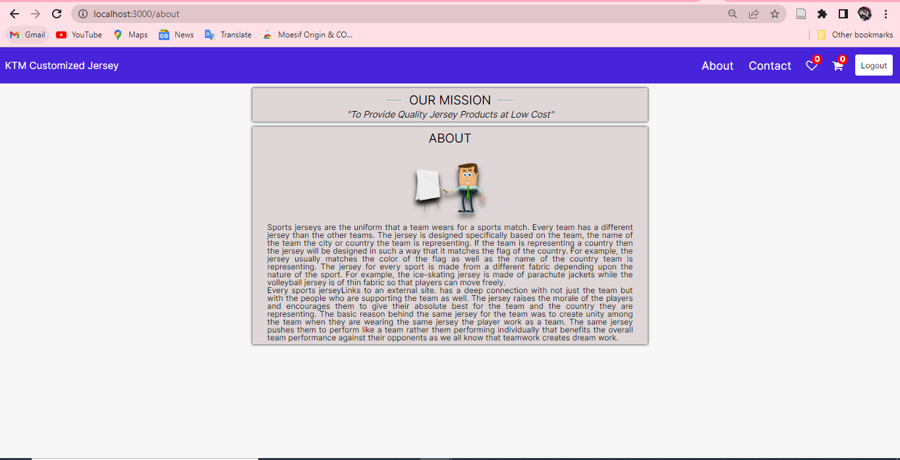
ABOUT PAGE

Slide 6
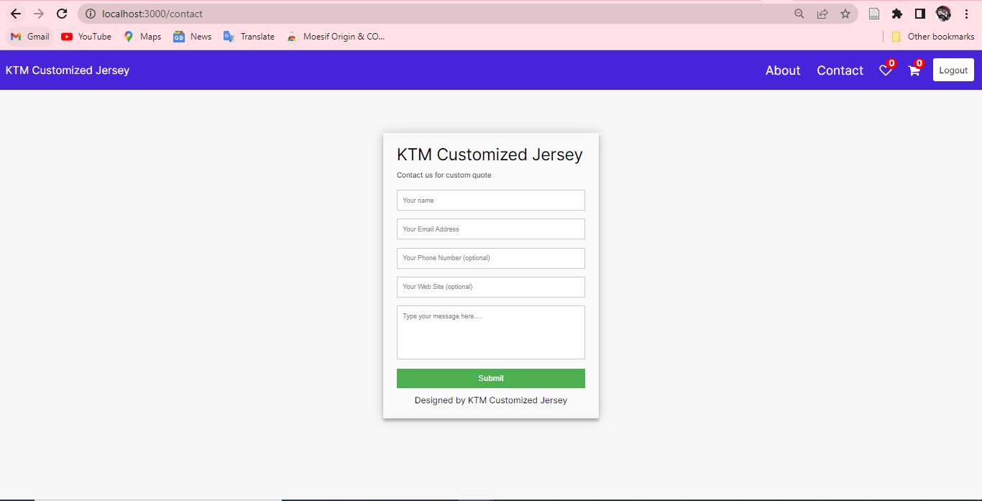
CONTACT PAGE

Slide 7
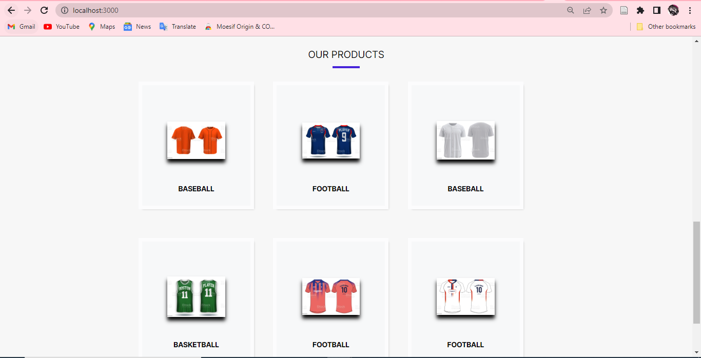
LIST OF PRODUCTS

Slide 8
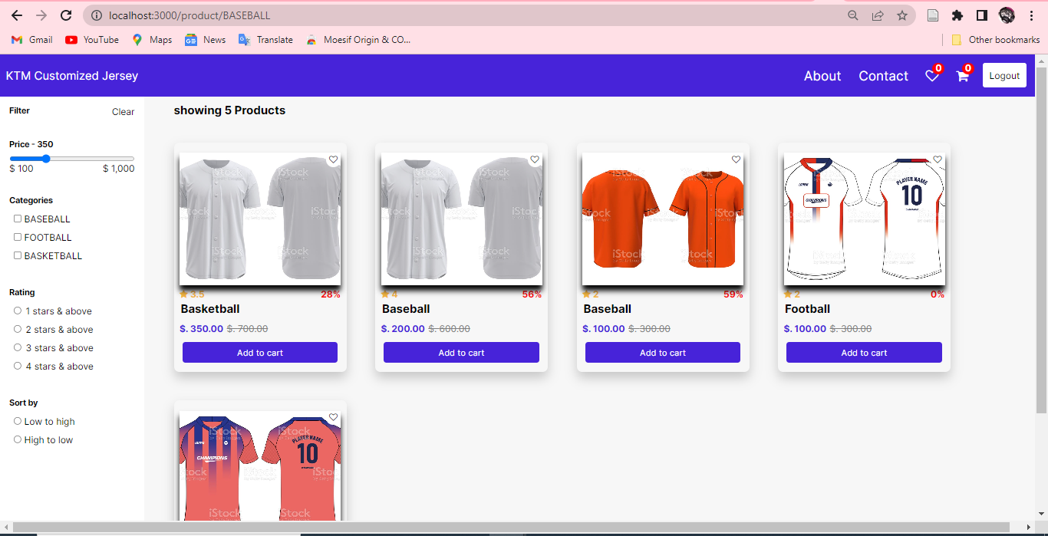
PRODUCTS WITH CATEGORIES

Slide 9
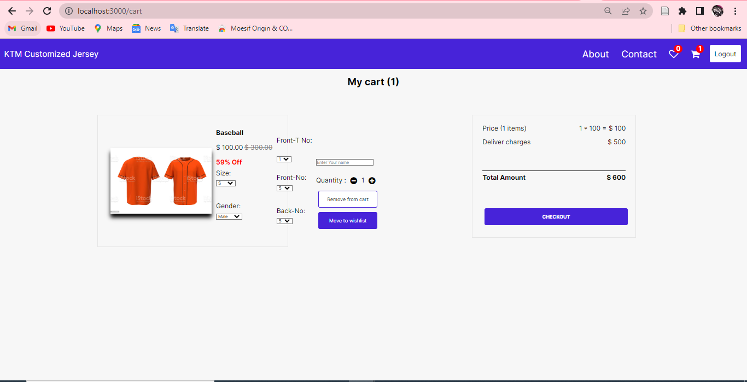
PRODUCT IN CART

Slide 10
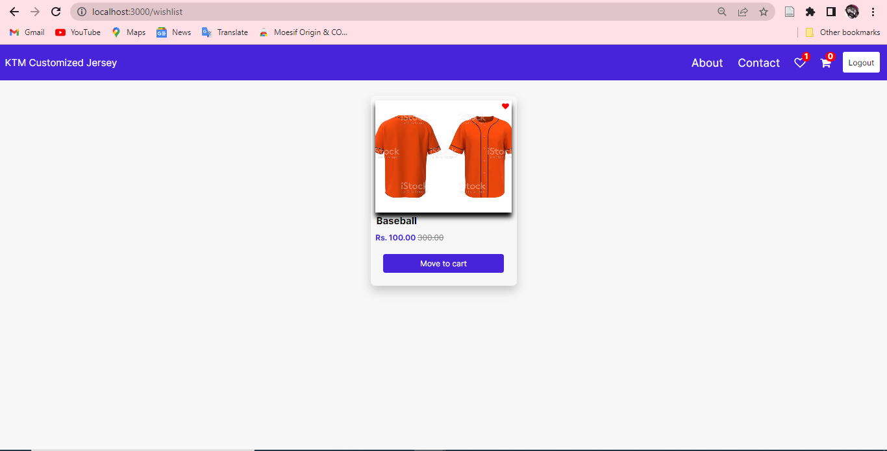
PRODUCT IN WISHLIST

Slide 11
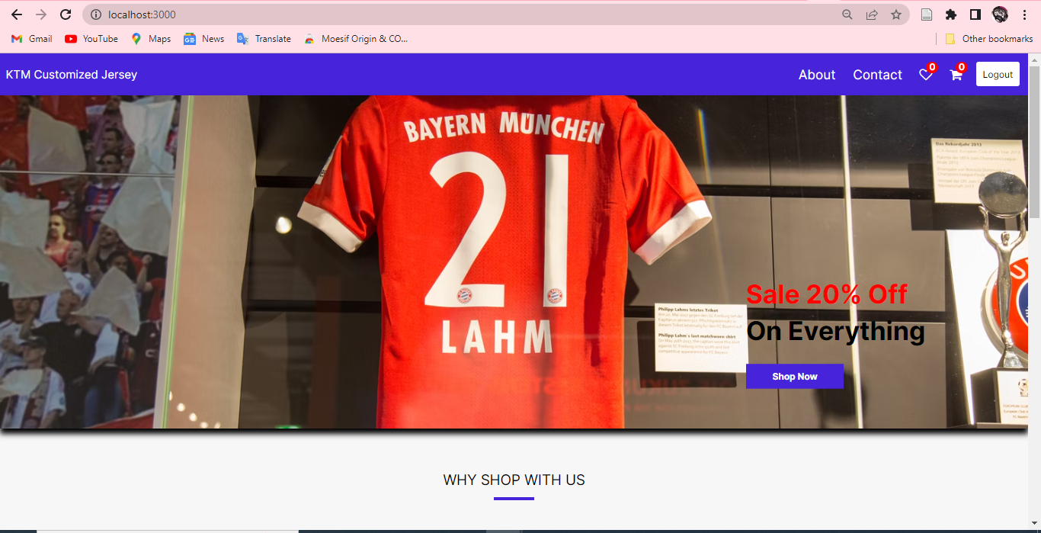
LOGGED IN USER Can see the logout button and perform all actions

